Slide 1
Gravitational lensing
Lecture 9
Docente: Massimo Meneghetti
AA 2015-2016

Slide 2
Today’s lecture
Lensing by point masses: observational signatures
  photometric microlensing
  astrometric microlensing

Slide 3
IMAGE configurations during a microlensing event
Image configuration during the microlensing event.
Source, Images and Lens are aligned at any time!
Gaudi, 2012, Ann. Rev. Astron. Astrophys. 50, 411

Slide 4
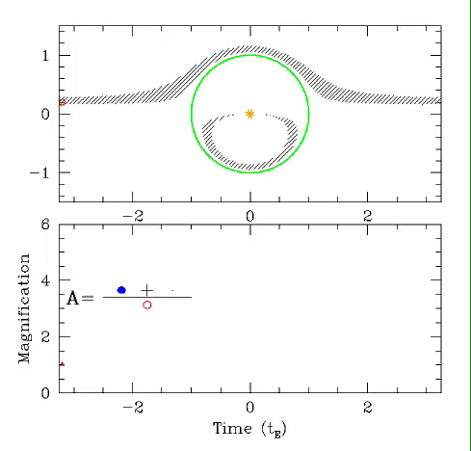
IMAGE configurations during a microlensing event
Courtesy of S. Gaudi

Slide 5
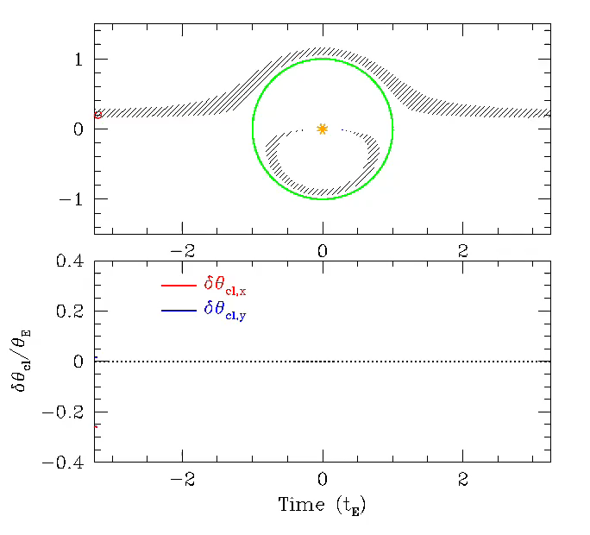
Astrometric microlensing (animation)
Courtesy of S. Gaudi

Slide 6
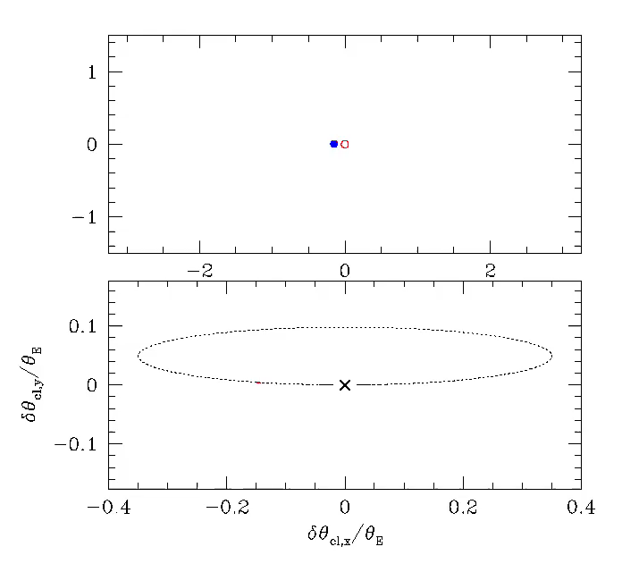
Astrometric microlensing (animation)
Courtesy of S. Gaudi

